Slide 2
FIT 152 Fundamentals of Information Technology
Lecture 4
Topic 3: Characteristics of an IT system

Slide 3
FIT 152: Module outcomes
Upon successful completion of this course, the student will be able to:
Demonstrate an understanding of the relationship between IT and related and informing disciplines.
Demonstrate insight in the history of computing technology, and an understanding of the Internet, and the World-Wide Web, as well as the components of an IT system and how they interrelate.
Demonstrate an understanding of complexity in an information technology environment and how and why it occurs.
Demonstrate an understanding of why life-long learning and continued professional development is critical for an IT professional.
Illustrate the use of information and communication technologies to solve problems.
Demonstrate an understanding of how and to what extent IT has changed various application domains.

Slide 4

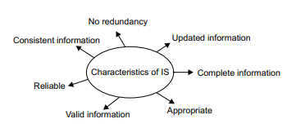
The components of an IT system and how they inter-relate
Read Gupta2020, pages 1 – 7
Read Pham2021, Chapter 2
A computer is an electronic device, operating under the control of instructions stored in its own memory, that can accept data (input), process the data according to specified rules, produce information (output) and store the information for future use.
What is a system?
Characteristics of IT Systems

Slide 5
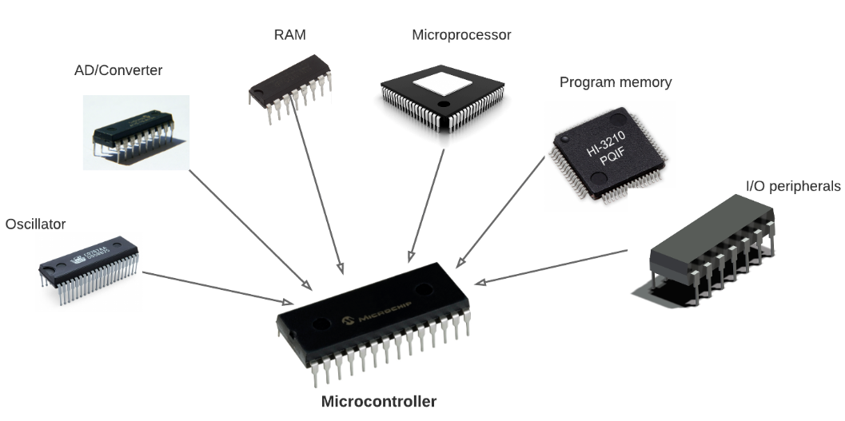
Hardware
Read Pham2021 Chapter 2
Digital devices
A digital device is any equipment containing a computer or microcontroller; included in these devices are smartphones, watches, and tablets. A digital device processes electronic signals that represent either a one (“on”) or a zero (“off”). The presence of an electronic signal represents the “ on ” state; the absence of an electronic signal represents the “ off ” state. Each one or zero is referred to as a bit (a contraction of binary digit); a group of eight bits is a byte.
Components of a digital device
Motherboard (circuit board)
Central Processing Unit ( CPU) - Graphical Processing Unit (GPU)
Random Access Memory (RAM)
Video Card Power Supply Hard Drive (HDD)
Solid-State Drive (SSD)
Optical Drive (DVD/CD drive)
Card Reader (SD/SDHC, CF, etc.)

Slide 6
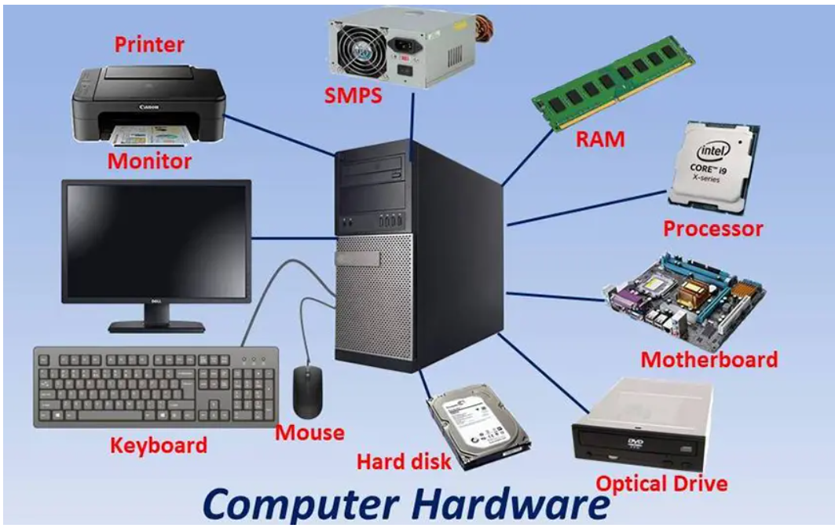
Match the device with the name
A
Optical drive
SMPS (Switched-mode power supply)
Mouse
Printer
Monitor
Hard disk
Motherboard
Processor
Keyboard
RAM
D
G
B
H
I
E
C
F
J

Slide 7
Answers
Printer
Monitor
Keyboard
SMPS (Switched-mode power supply)
Mouse
Hard disk
RAM
Processor
Motherboard
Optical drive

Slide 8
Complexity in IT
Read Printz2020, Foreword, pages ix and x
Introduction to Part 1, pages 3 and 4
Part 1, pages 5 to 31
A system is a set of interacting entities
Systems Thinking: A Little Film About a Big Idea | Introduction to Cabrera Research Lab (youtube.com)
Cybernetics is the science of automatic control systems (such as the human brain, driving a motorcar and our central nervous system) and communications in both living things and in machines.
(26) What is CYBERNETICS? (2016 ver.) Get it right in under 3 min. – YouTube
Next lecture: Management of complexity in IT

